Slide 1
Harrison Production Services, LLC
a little bit about us…

Slide 2
General Business Information
Limited Liability Company (LLC)
Sole proprietorship
Hal Harrison, owner
Located in Greer, SC

Slide 3
Personal Background
Grew up in Lyman, SC and attended James F. Byrnes High School.
First involved in audio at my home church (Wellford Baptist Church).
As an undergraduate, began working with local bands and churches on how to improve their audio requirements.
In graduate school, worked with a regional sound company (Rock Quarry Productions) as an audio technician and engineer.
After graduate school, returned back to upstate SC and started Harrison Productions.
Have worked as an audio engineer and AV systems designer and contractor since.

Slide 4
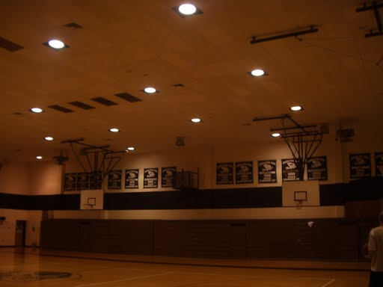
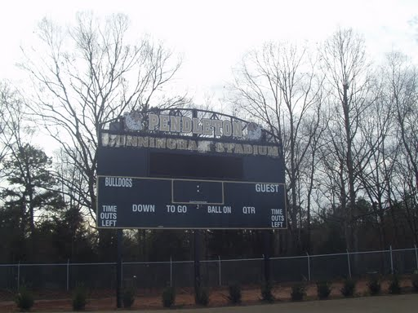
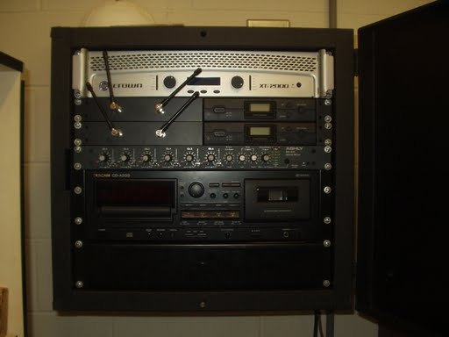
Recent AV Design/Build Projects
Pendleton High School
Auditorium audio system
Gymnasium audio system
Football stadium audio system

Slide 5
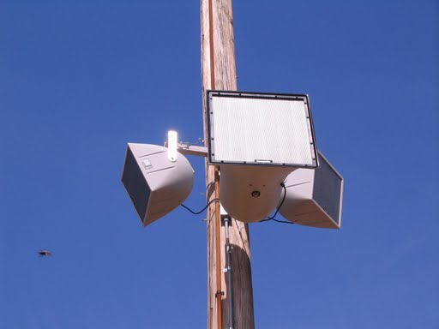
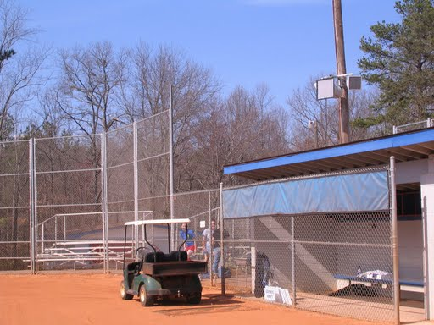
Recent AV Design/Build Projects
Spartanburg County School District Five
Byrnes Lady Rebels’ Softball Field audio system
Berry Shoals Intermediate School Library audio system

Slide 6
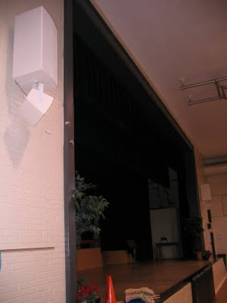
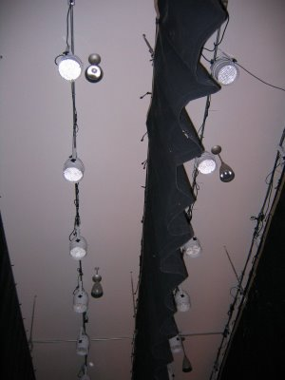
Recent AV Design/Build Projects
Starr-Iva Middle School
Audio and lighting systems for gymnatorium

Slide 7
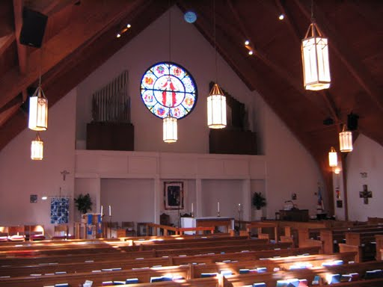
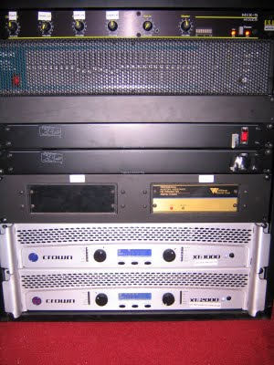
Recent AV Design/Retrofit Projects
Holy Trinity Episcopal Church – Clemson, SC

Slide 8
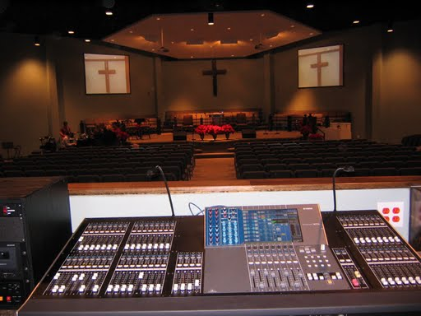
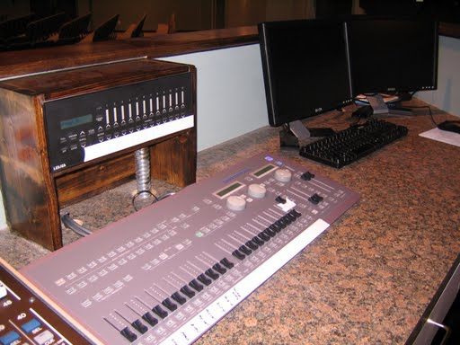
Recent AV Design/Consultant Projects
Hoffmeyer Road Baptist Church – Florence, SC
Audio, video, lighting, and IMAG systems for new sanctuary.

Slide 9
AV References
Kevin Gray, Hoffmeyer Road Baptist Church - Florence, SC
Chris Kinard, His Vineyard Church - Greer, SC
Eric Peters, Foothills Community Church - Seneca, SC
Mike Ruthsatz, Starr-Iva Middle School - Starr, SC
Randy Abbott, Anderson School District 4 - Pendleton, SC
Jeff Rogers, Byrnes High School - Duncan, SC

Slide 10
www.harrisonpro.net
for more information.

